Slide 1
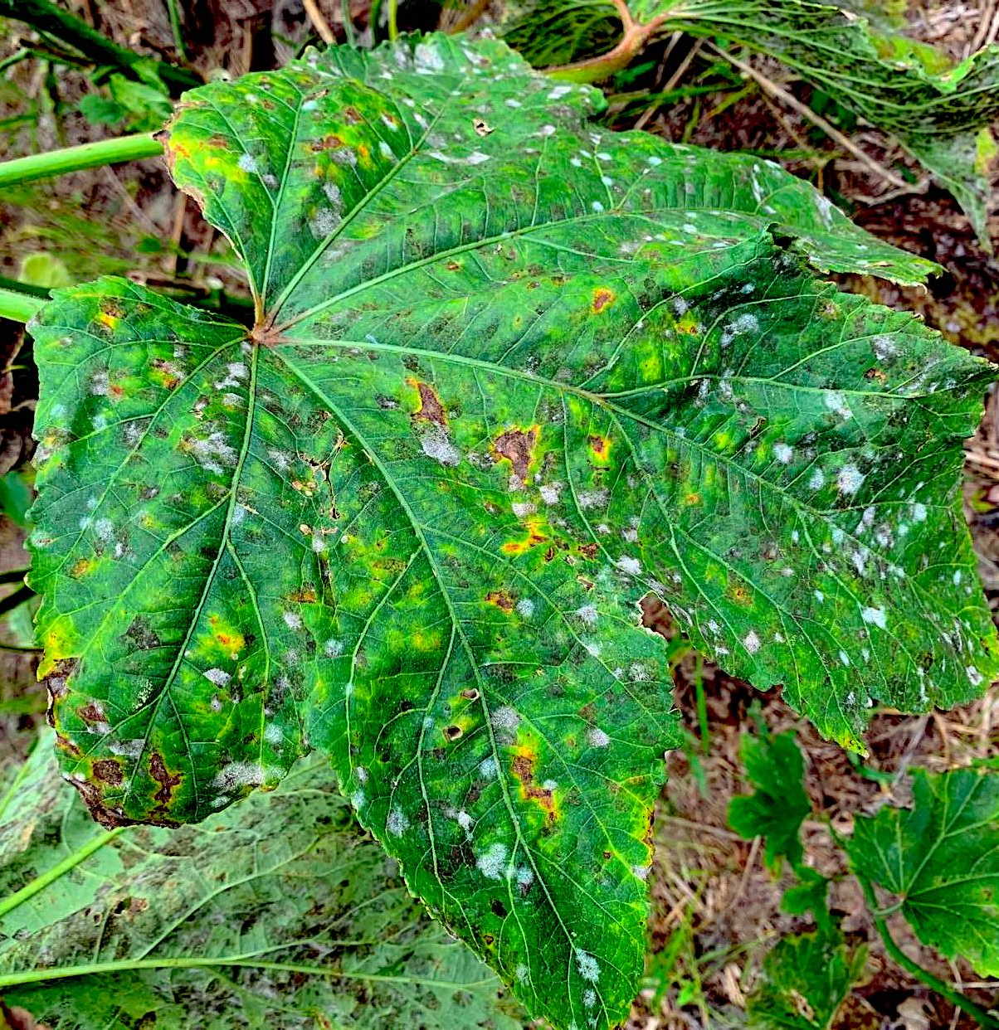
Life Cycle and ID of foliar fungal pathogens
“Advancing the skills of regional agriculture professionals in plant diagnostics”
Leilani G. Sumabat Dacones
University of the Philippines Diliman

Slide 2
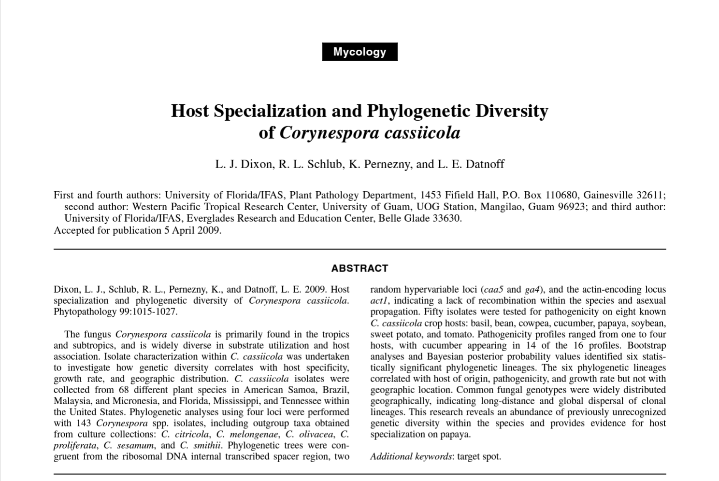

Slide 3
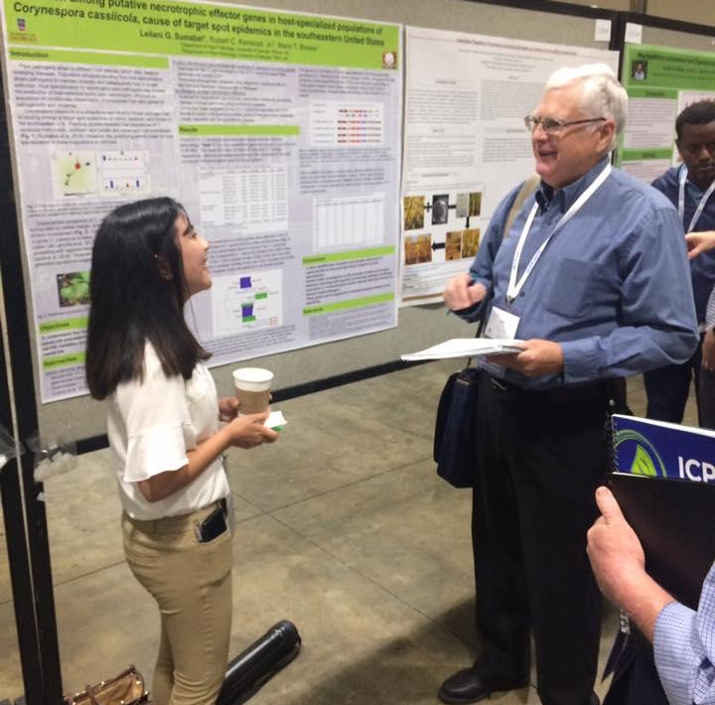

Slide 4
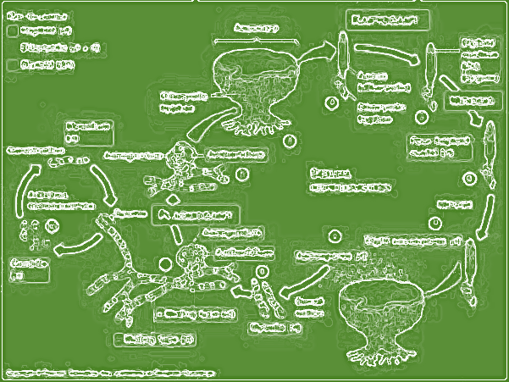
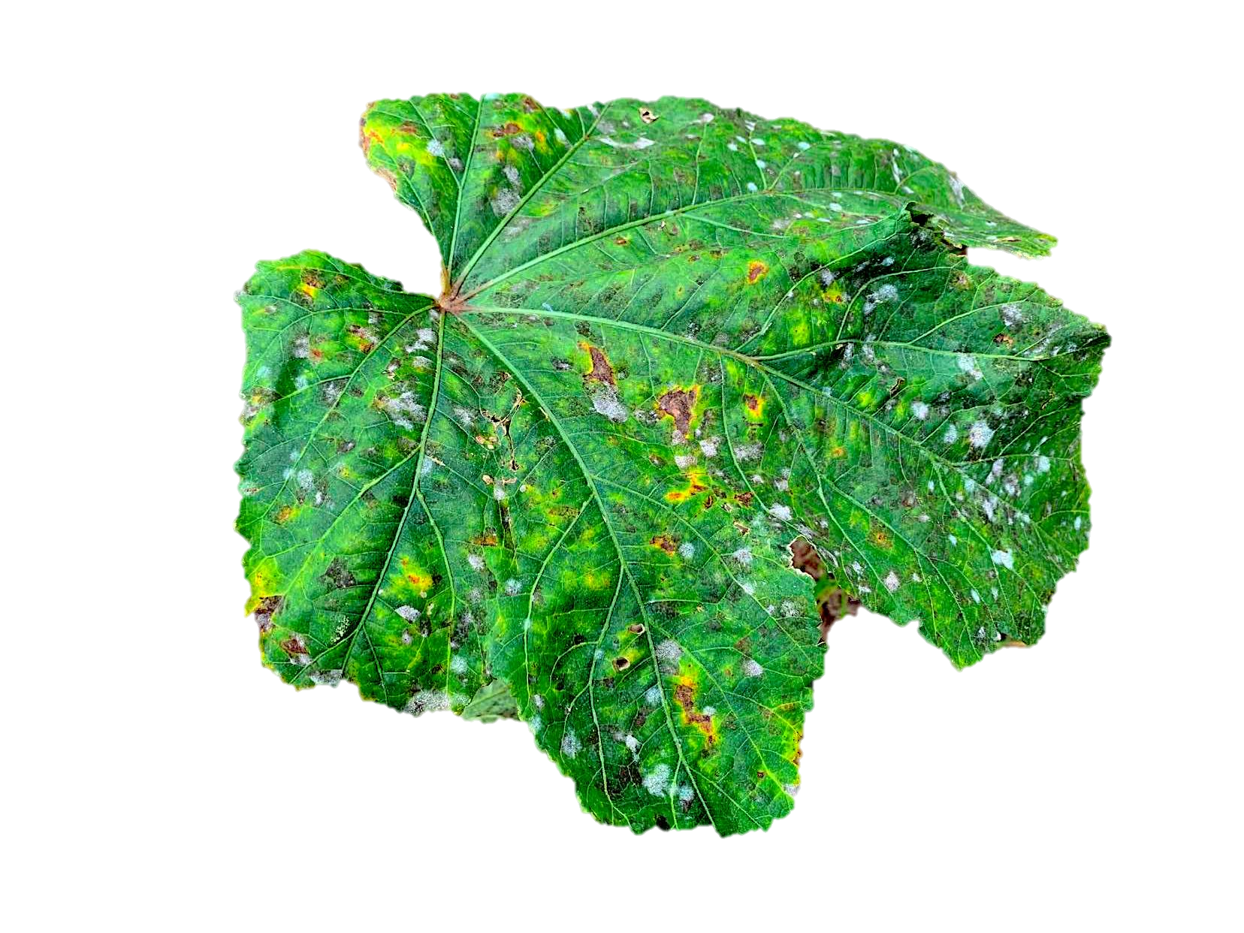
Outline
Foliar fungal pathogens
Fungal identification
Life cycle (disease cycle)

Slide 5
Foliar fungal pathogens
Corynespora
Cercospora
Other related fungi
Alternaria, Passalora, Pseudocercospora

Slide 6
Foliar fungal pathogens
Different fungi cause different diseases
Different species within same genus cause different diseases
Same species can affect multiple different hosts
Cause plant damage and economic losses
Infected flag or active leaf, yield impacts
Correct ID and implementing appropriate strategies to manage fungal diseases

Slide 7
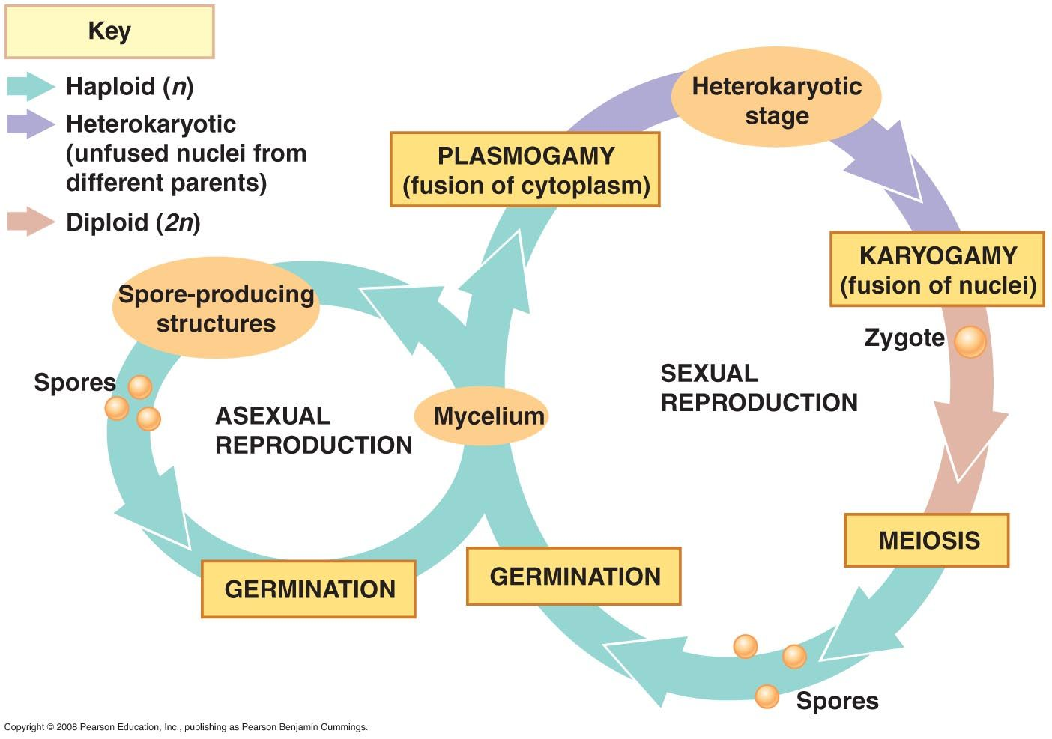
General life cycle of a fungus

Slide 8
General disease cycle
Survival
Production of survival structures
Production of primary inoculum
Primary infection cycle
Colonization
Dispersal of primary inoculum
Symptoms
Infection
Secondary infection cycle
Production of secondary inoculum
Dispersal of secondary inoculum
A.Fulmer 2012

Slide 9
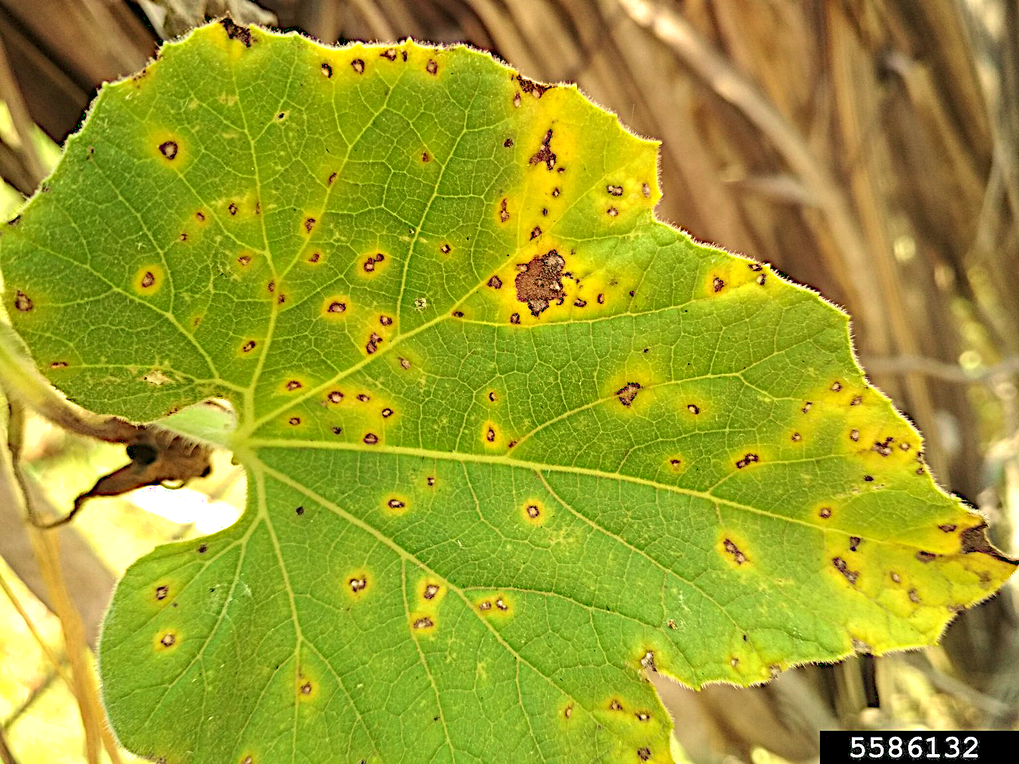
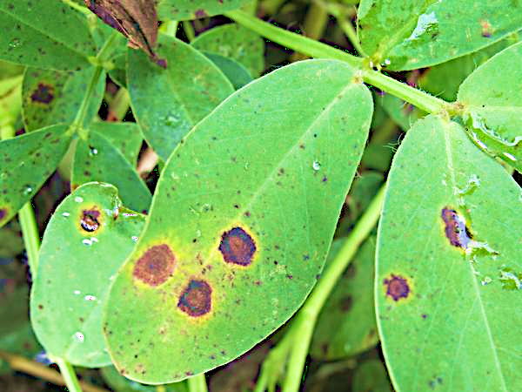
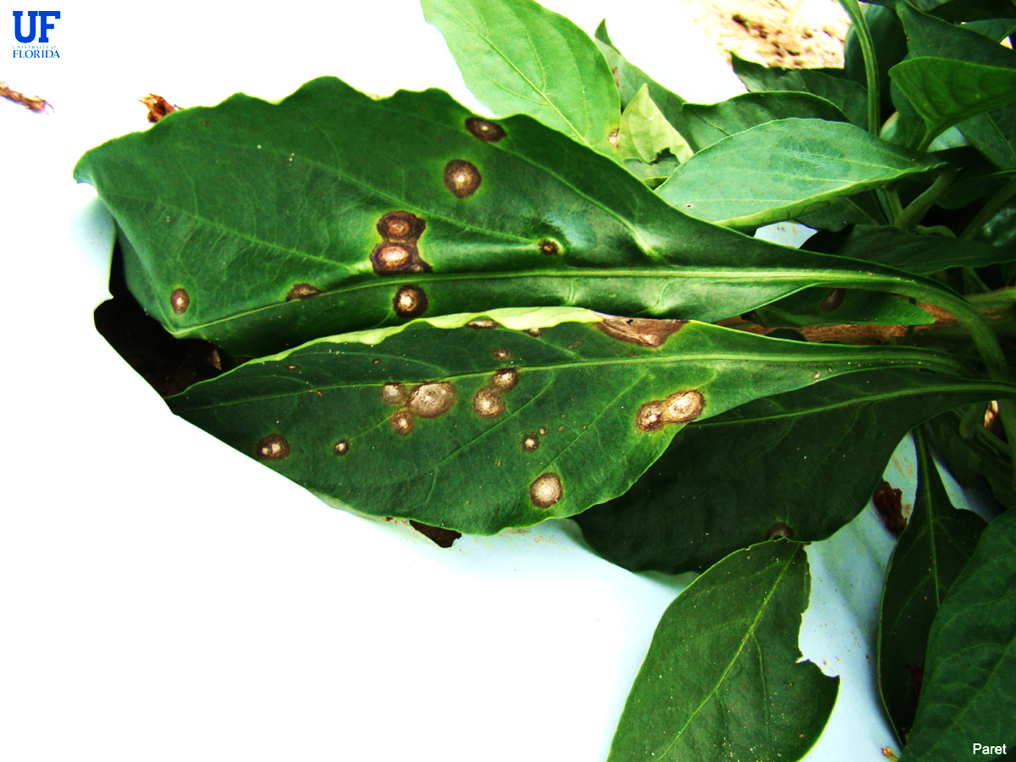
Foliar diseases caused by Cercospora
~2000 species within the genus Cercospora
Cause of leaf spot or blight diseases on a wide range of hosts
Allium, brassicas, citrus, cucurbits, peanut, pepper, tomato, etc.
Seethapathy 2019
Shew 2020
Paret 2021
Cercospora leaf spot of cucurbit
Early leaf spot of peanut
Frogeye leaf spot of pepper
Schlub RL (2018) Index of Plant Diseases In Guam

Slide 10
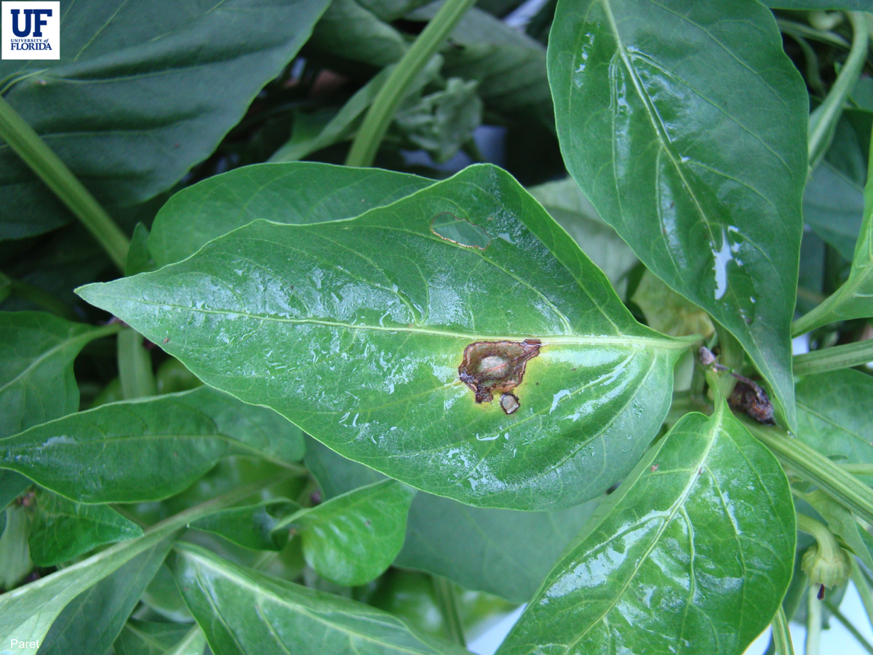
Frog eye leaf spot of pepper
Symptoms
circular lesions with a white center on the leaves
Frog-eye appearance
Water soaking
Paret 2021

Slide 11
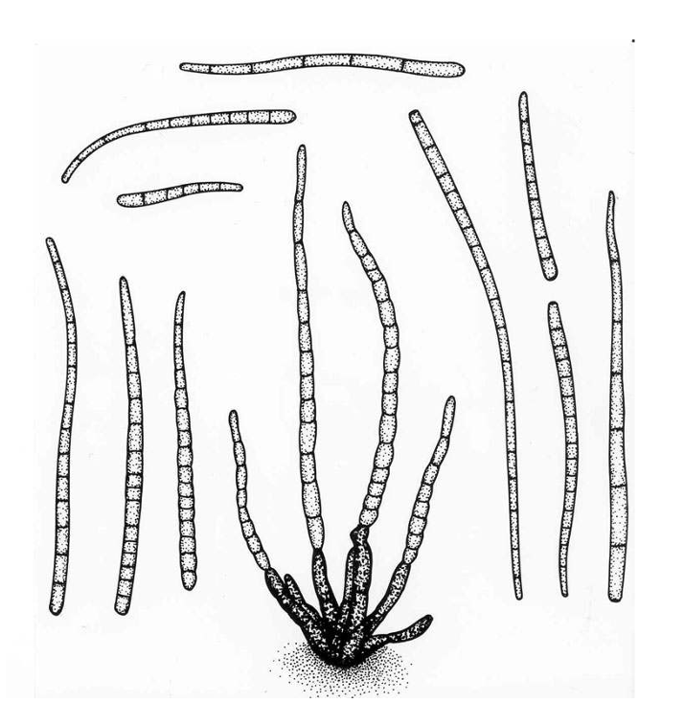
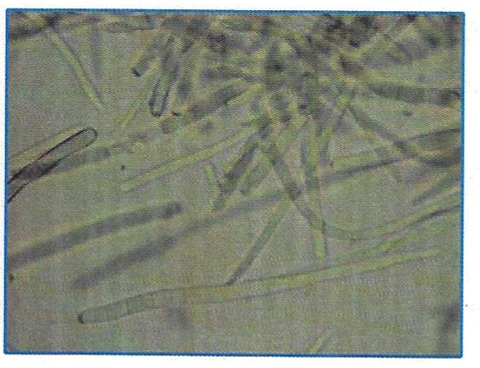
Morphological features of Cercospora
Spore or conidia
Elongate to fusiform
Tapering toward the tip
10-20 septa
Golasyn-Wright 1990
Woodward 2014

Slide 12
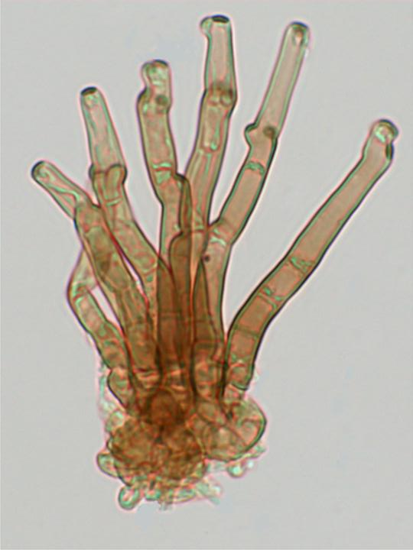
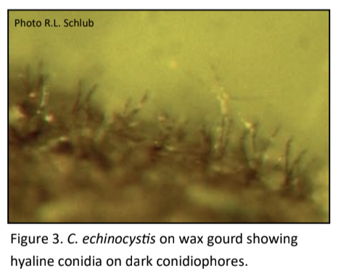
Morphological features of Cercospora
Conidiophore
Septated
form in pseudostromata (tightly packed)
In fascicles
Golasyn-Wright 1990
McKenzie 2014

Slide 13
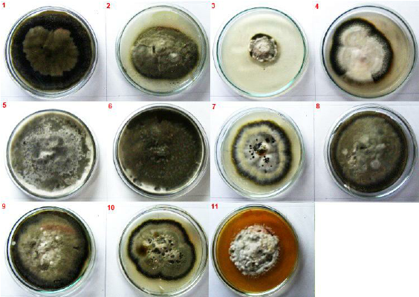
Colony morphology of Cercospora
Variable colony color, rates of growth and sporulation
Esh and Moghaieb 2011
C. beticola isolates in PDA

Slide 14
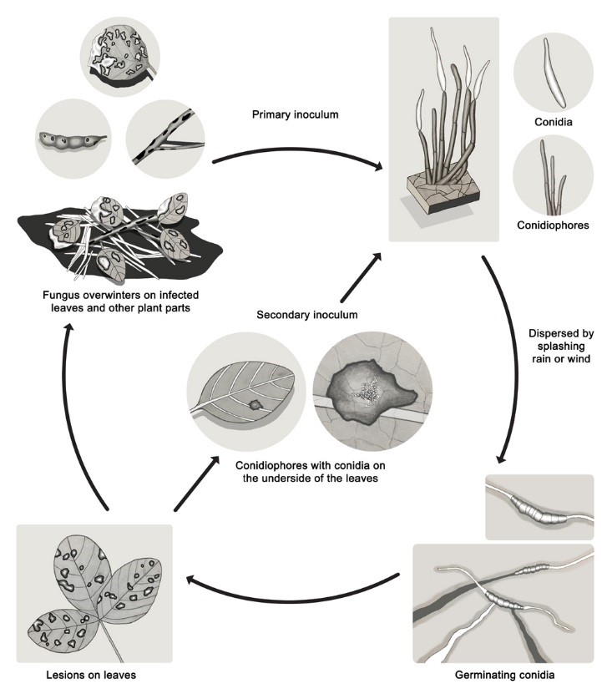
Disease cycle of frogeye leaf spot
A. Grahek 2018

Slide 15
Foliar diseases caused by Pseudocercospora
Leaf spot symptoms associated with various species from the Pseudocercospora complex
Crous et al. 2013

Slide 16
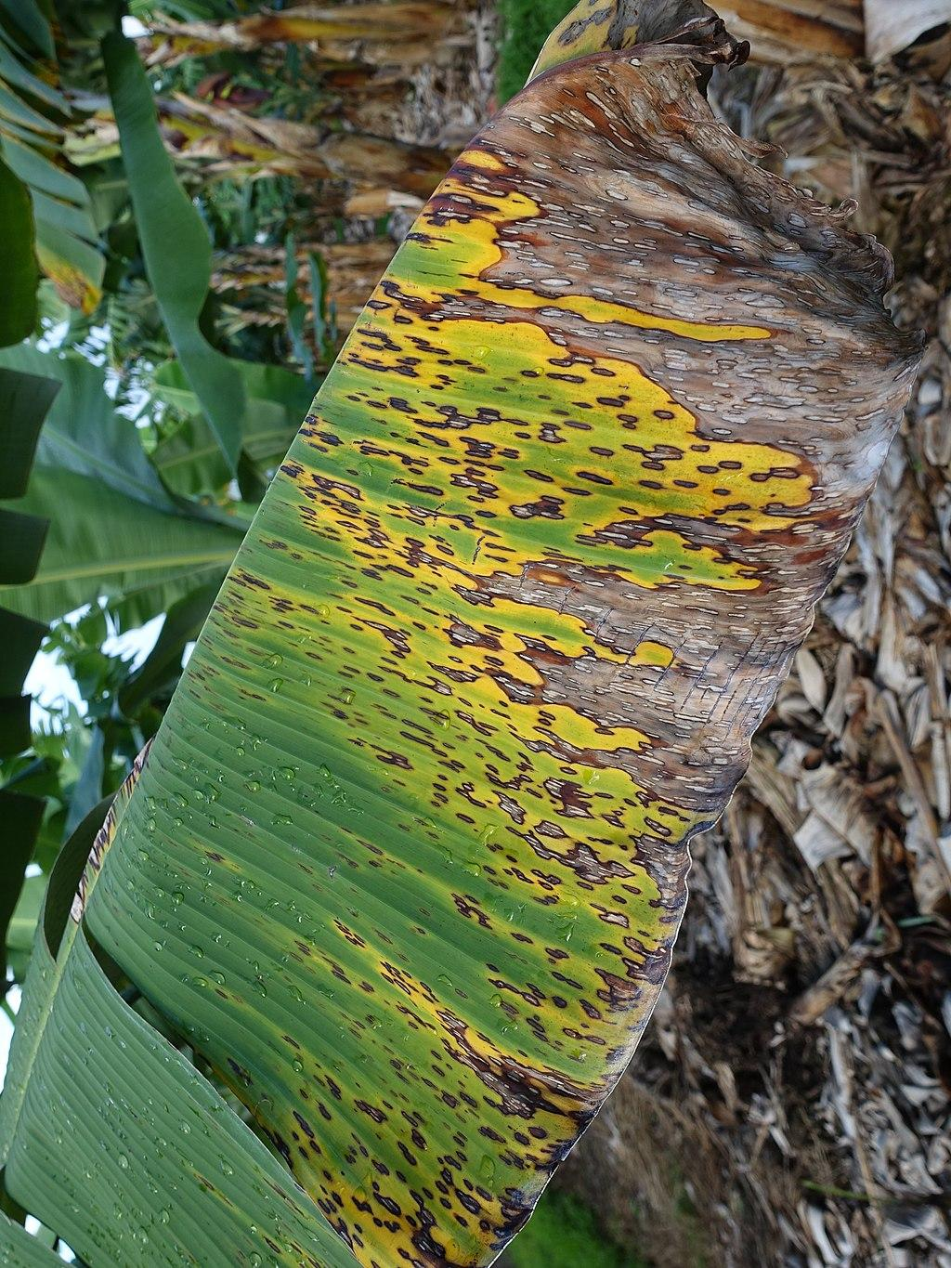
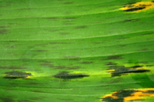
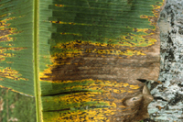
Foliar diseases caused by Pseudocercospora
Black sigatoka of banana
Bennett and Arneson 2003
Nelson 2016

Slide 17
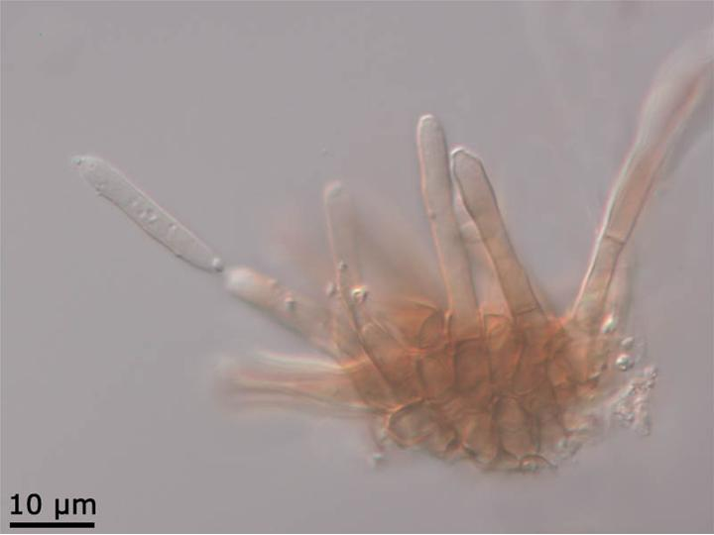
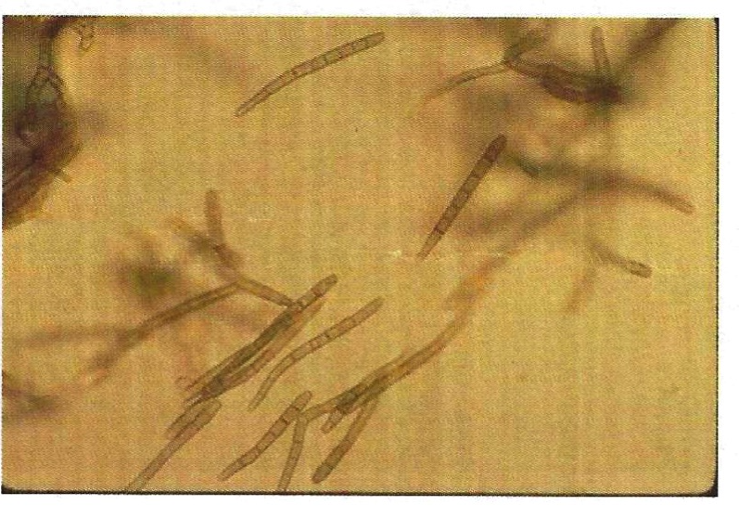
Morphological features of P. fijiensis
Asexual: Conidia and conidiophore
Vézina 2017
Woodward 2014
Conidiophores: short, non pigmented, often clustered at the base (fascicle), conidial attachment scar oftentimes not visible
Conidia: hyaline, elongated with base slightly larger than the terminal end, shorter and wider than Cercospora

Slide 18
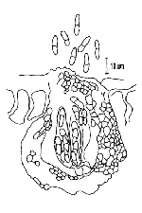
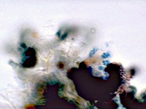
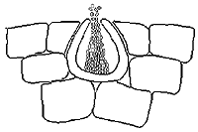
Morphological features of Mycosphaerella fijiensis
Sexual: Ascus, ascospores, pseudothecia
Bennett and Arneson 2003

Slide 19
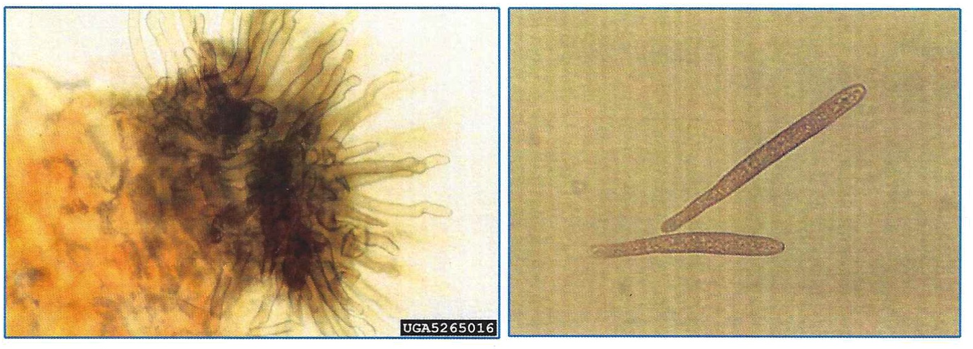
Morphological features of Passalora
Conidiophore and conidia
Pigmented
Conidiophores in fascicle
Conidia elongated with base slightly larger than terminal end, conidial attachment scar visible
Woodward 2014

Slide 20
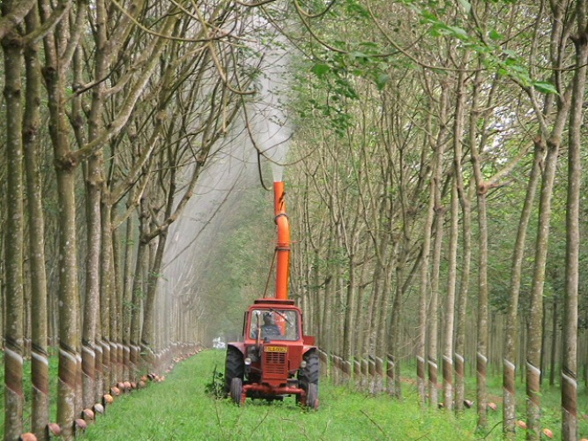
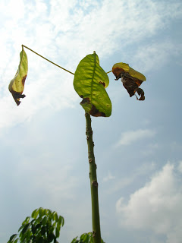
Foliar diseases caused by Corynespora cassiicola
Causes Corynespora leaf fall of rubber
Major problem in rubber growing areas
Massive defoliation on rubber trees MVM Technologies
Lesions on the leaves Thomson

Slide 21
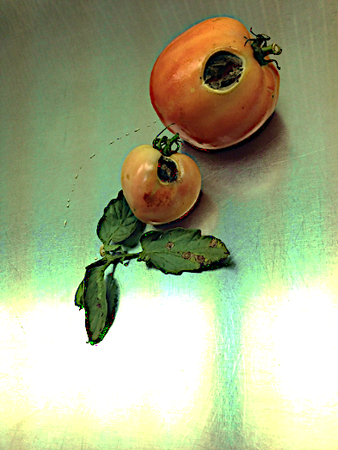
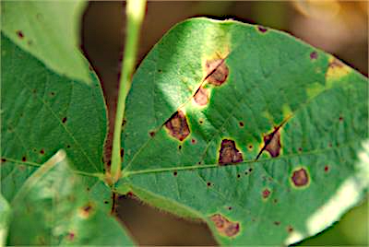
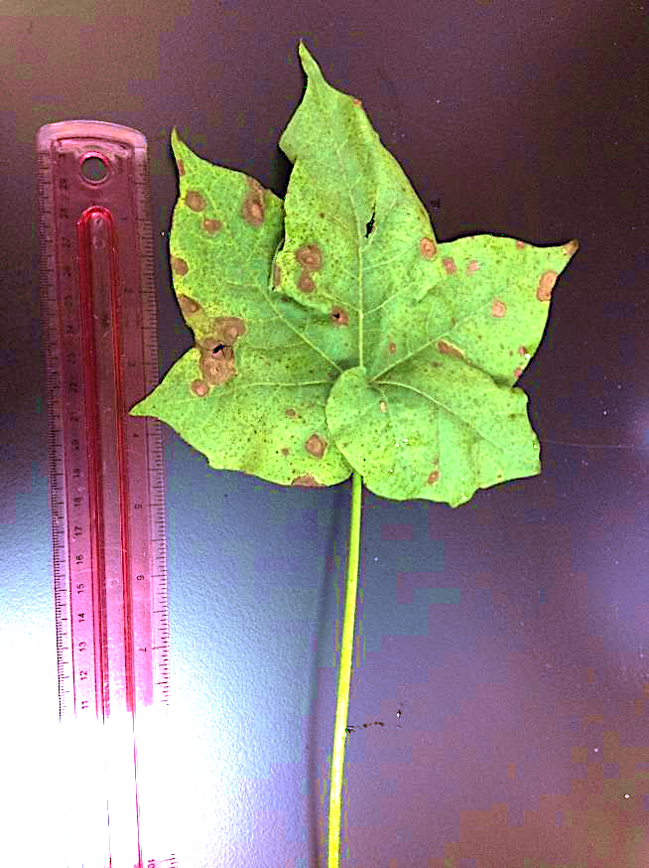
Foliar diseases caused by Corynespora cassiicola
Target spot diseases
Tomato
Soybean (T. Allen)
Cotton

Slide 22
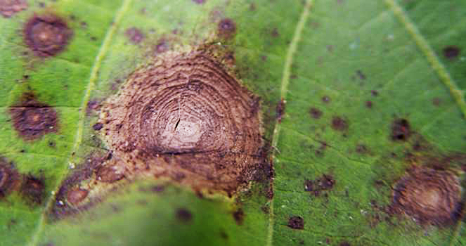
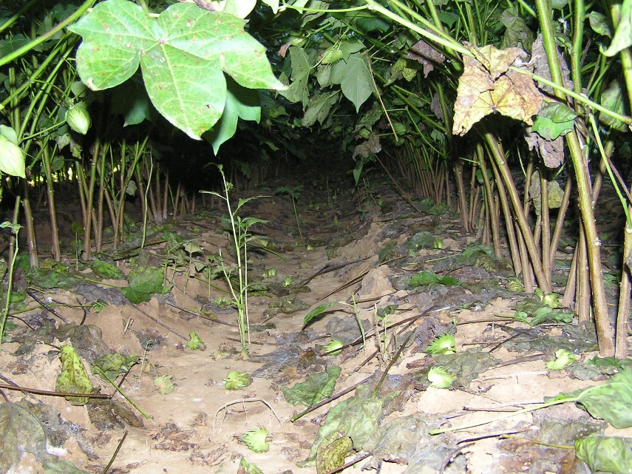
Target spot of cotton
Symptoms
Target-like appearance
Necrotic lesions with yellow margins
Premature defoliation
Characteristic target spot on leaf E.Beasley
Premature defoliation on cotton LSU-AgCenter

Slide 23
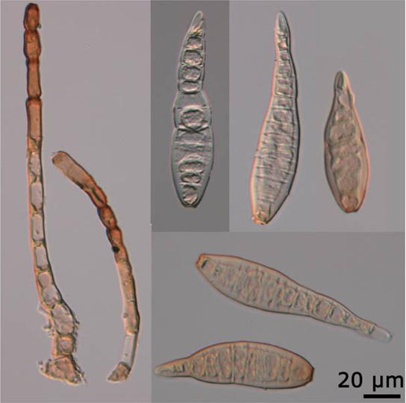
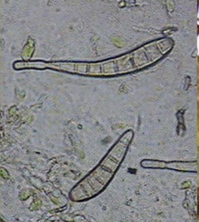
Morphological features of Corynespora cassiicola
Conidia
Appear multicellular (pseudosepta)
produced in chains
Conidiophore
erect,simple or occasionally branched, straight or slightly flexuous, smooth, septate
Asexual structures of C. cassiicola J.R. Liberato

Slide 24
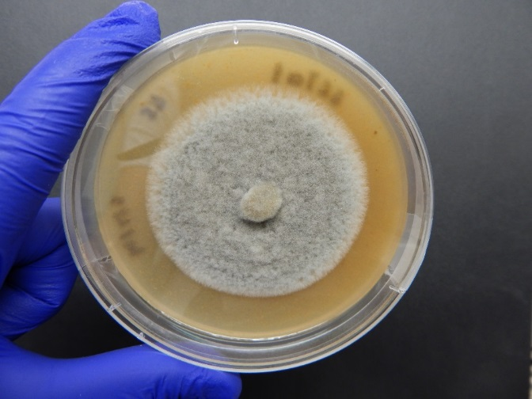
Colony morphology of Corynespora cassiicola
Culture
effused colonies of either grey or brown color, thinly hairy
C. cassiicola isolate in V8 agar plate

Slide 25
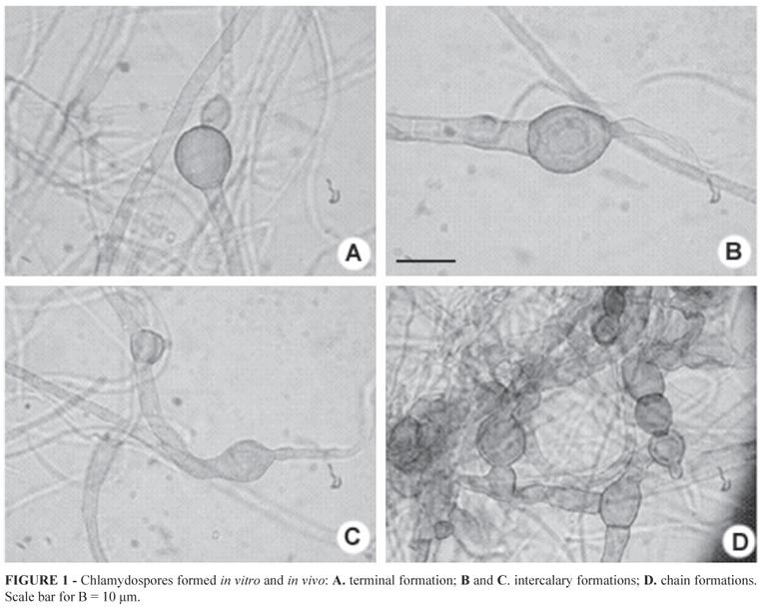
Disease cycle of target spot of cotton
Survival
Oliveira et al. 2012
Production of survival structures
Production of primary inoculum
Primary infection cycle
Colonization
Dispersal of primary inoculum
Symptoms
Infection
Secondary infection cycle
Production of secondary inoculum
Dispersal of secondary inoculum
A.Fulmer 2012

Slide 26
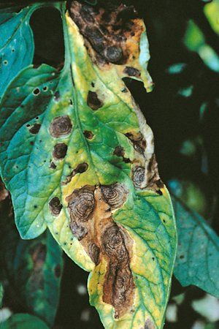
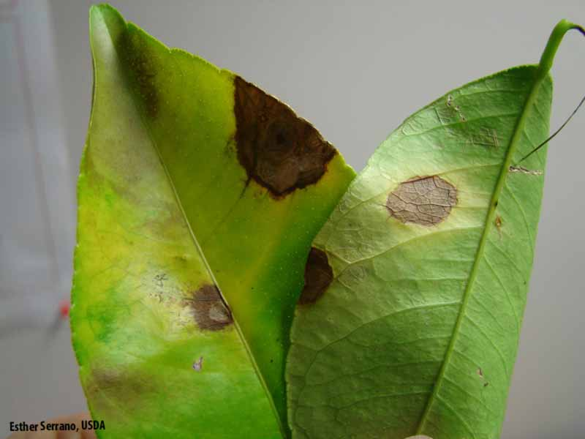
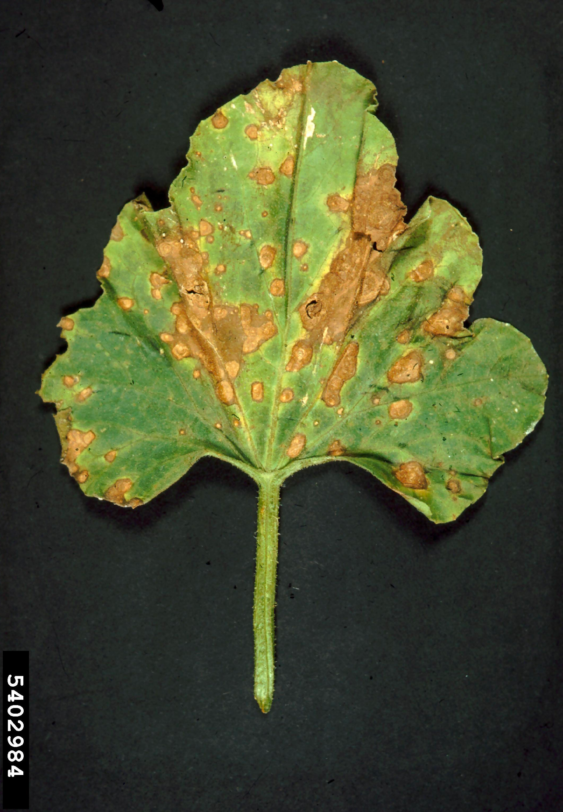
Foliar diseases caused by Alternaria
Infect a variety of widespread crops
W.R. Stevenson 2002
R.W. Samson 2009
Early blight of tomato
Brown spot of cantaloupe
Alternaria brown spot of citrus

Slide 27
Early blight of tomato
Symptoms
Initial 1-2mm black/brown small lesions
Later develops dark pigmented concentric rings
Chlorosis in infected leaves
Defoliation
W.R. Stevenson 2002
Early blight of tomato

Slide 28
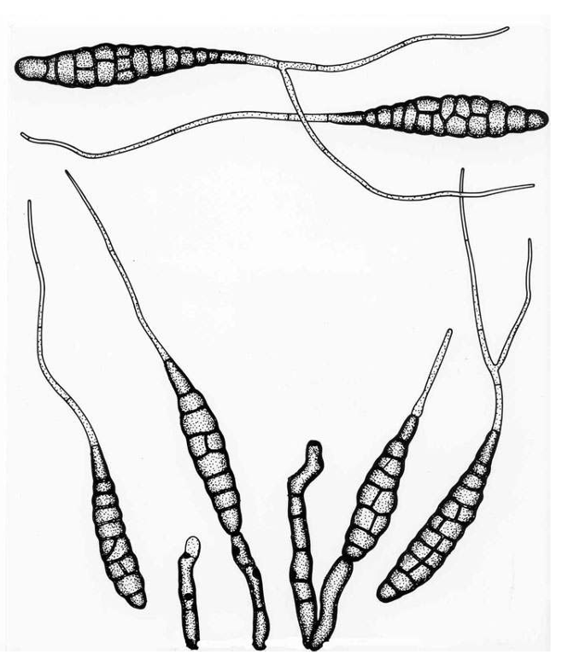
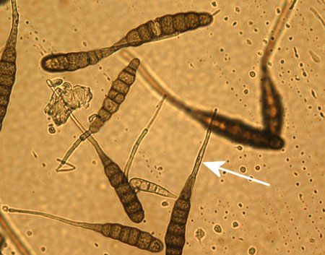
Morphological features of Alternaria
Conidia
borne singly or in a chain of two on distinct conidiophores
normally possess 9–11 transverse septae
Conidiophore
short or elongate
Golasyn-Wright 1990

Slide 29
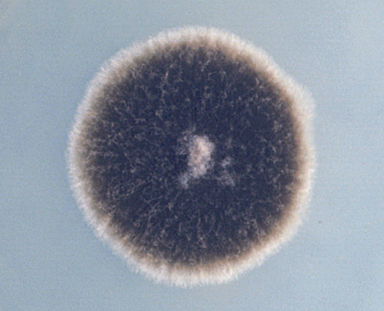
Colony morphology of Alternaria
black to olivaceous-black or greyish
Ellis 1971
A. alternata isolate in PDA

Slide 30
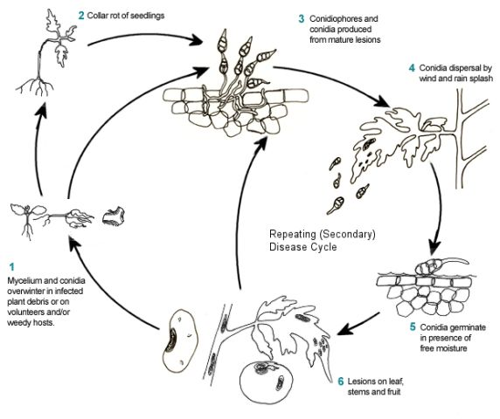
Disease cycle of early blight of tomato
Kemmitt 2002

Slide 31
Summary
Signs and symptoms in disease diagnosis
Pathogen biology – morphology and life cycle

Slide 32
Questions?
lsdacones@up.edu.ph

